Slide 1

Best-selling Video Games Analysis
Tengzhe ZHANG
Mis à jour: 16.11.2025
Web Scraping & Data Processing

Slide 2
Background & Objectives
Video games are a major entertainment industry; best-sellers reflect player preferences and market trends.
This project analyzes best-selling video games from Wikipedia to understand sales patterns across titles, years, franchises, and platforms.

Slide 3

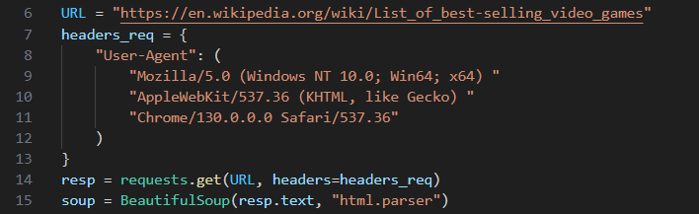
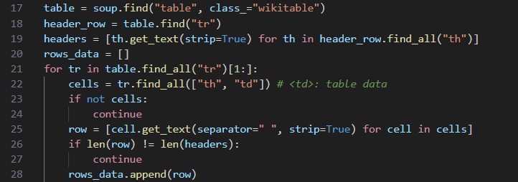

Data Source & Web Scraping
Source:
Wikipedia page: “List of best-selling video games”
url = “https://en.wikipedia.org/wiki/List_of_best-selling_video_games”
Tools:
requests + BeautifulSoup for web scraping
pandas for data handling
Process:
Download the HTML page using requests.get()
Use BeautifulSoup to locate the best-selling games table
Parse rows to extract title, sales, platforms, release date, developer/publisher, etc.
Store results in a pandas.DataFrame and export as .CSV

Slide 4
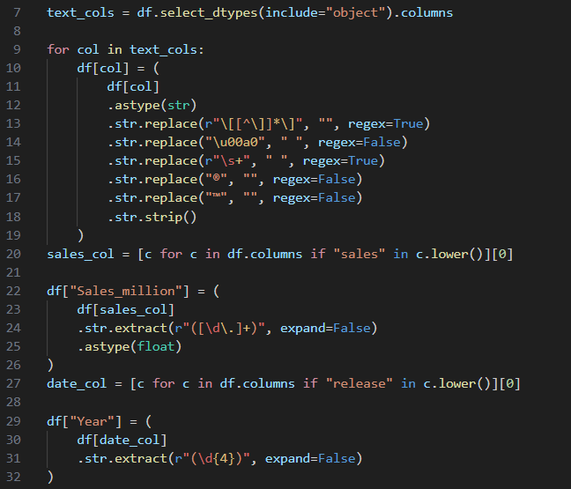
Data Cleaning
Cleaning steps:
Remove footnote markers like [1], [a].
Strip extra spaces and special characters.
Field transformations:
sales_millions: extract numeric values from strings like "82.90 million" → float
release_year: extract year from full release date → int.

Slide 5
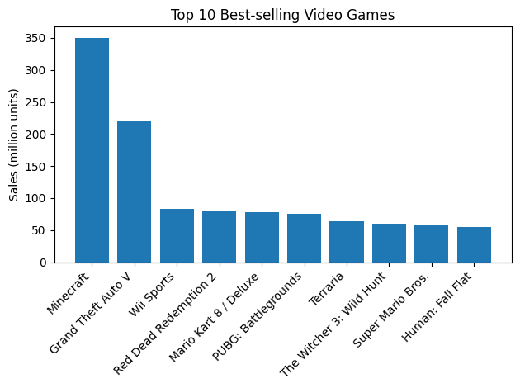
KPI 1 – Total sales
Objective:
Identify the most successful individual titles in the dataset
KPI Definition:
Rank games by Sales_million and select the Top 10
Visualization:
Bar chart: Title, Sales(million units)
Key Insight:
A small group of top titles clearly stand out from the rest.
The gap between the first few games and the lower-ranked games suggests a strong “blockbuster” effect.

Slide 6

KPI 2 – Total Sales of All Games
Objective:
Measure the overall market size represented by the dataset
KPI Definition:
total_sales = df["Sales_million"].sum()
Key Insight:
The total sales figure shows how large the combined market is for these best-selling titles.
This can be used as a reference point when discussing the contribution of top games.

Slide 7
KPI 3 – Median Sales per Game
Objective:
Understand what a “typical” best-selling game sells
KPI Definition:
median_sales = df["Sales_million"].median()
Key Insight:
The median separates high-performing blockbusters from lower-end best-sellers.
Comparing the median with the sales of each game can highlight skewness.

Slide 8

KPI 4 – Share of Sales from Top 5 Games
Objective:
Quantify how concentrated total sales are in a few games
KPI Definition:
Sum sales of Top 5 titles and divide by total_sales
Key Insight:
A high percentage indicates that a small number of titles dominate the market.
This supports the idea that the video game market is strongly driven by a few flagship games.

Slide 9
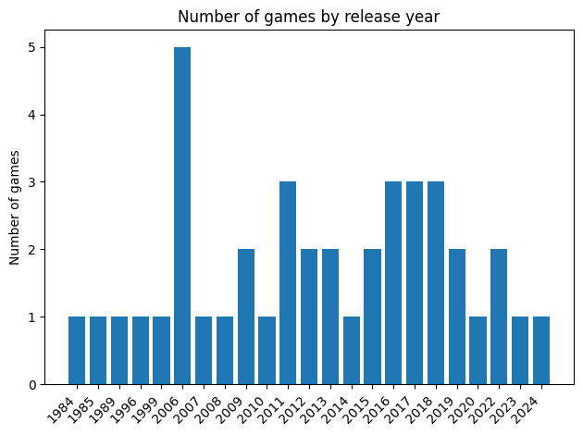
KPI 5 – Number of Games by Release Year
Objective:
See when best-selling games were released and identify active periods
KPI Definition:
Count of games per Year
Visualization:
Bar chart: Release Year, Number of games
Key Insight:
Certain years show a spike in the number of best-selling releases.
These peaks may correspond to new console generations or major industry cycles.

Slide 10
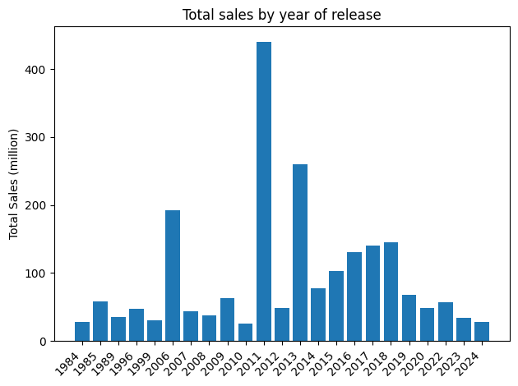
KPI 6 – Total Sales by Release Year
Objective:
Measure how much sales volume is associated with each release year
KPI Definition:
Group by Year and sum Sales_million
Visualization:
Bar chart: Release Year, Sales(million units)
Key Insight:
Some years generate much higher total sales due to one or more blockbuster releases.
Comparing KPI 5 and 6 reveals whether high sales come from many games or from a few extremely successful ones

Slide 11
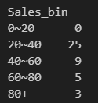
KPI 7 – Sales Distribution by Range
Objective:
Understand how games are spread across different sales ranges
KPI Definition:
Bin Sales_million into ranges such as [0~20, 20~40, 40~60, 60~80, 80+]
Key Insight:
Most games fall into certain sales bands, while only a few reach the very top range.
This highlights how difficult it is for a game to reach extremely high unit sales.

Slide 12
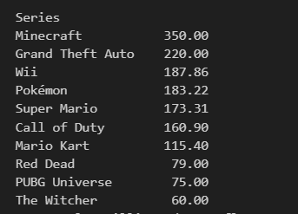
KPI 8 – Sales by Series
Objective:
Evaluate which game series are the strongest over time
KPI Definition:
Group by series and sum Sales_million; show the top series
Key Insight:
A few franchises account for a large share of total sales.
This indicates the power of strong IPs and sequels in the video game market.

Slide 13

KPI 9 – Single vs Multi-Platform Games
Objective:
Examine how platform strategy appears among best-selling games
KPI Definition:
Classify each game as Single-platform or Multi-platform and count games in each group
Key Insight:
The relative counts show whether multi-platform releases are common among best-sellers.
If multi-platform games have higher average sales, this suggests that broader platform coverage can help maximize units sold.

Slide 14
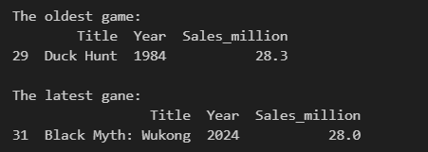
KPI 10 – Oldest vs Newest Game Sales
Objective:
Compare sales performance of the earliest and most recent releases in the dataset
KPI Definition:
Find the game with the minimum Year and the game with the maximum Year, and show their Sales_million
Key Insight:
This comparison illustrates how long-term classics and recent hits both contribute to the list of best-sellers.
It helps to discuss whether older games still dominate, or if newer titles are catching up.

Slide 15
Merci pour votre attention

